Slide 1

Web Based Class Scheduling for DMU Burie Campus
STUDENT NAME STUDENT ID
1.Dessie Aweke…………………….14059134
2.Yhalem Ayalu……………………...1404472
3.Shibesh Taddele…………………...1404221
4.Eyerusalem Girmachew…………...1403837
ADVISOR : Mr. Andargie Mekonen(M.Sc)
May/2025

Slide 2
Chapter one : Introduction
1. Introduction
which ensures that courses, instructors, room and facilities are properly organized. However, our university still relies on manual scheduling methods,
Managing academic schedules at DMU Bure Campus manually is inefficient.
This project introduces web based scheduling system to enhance efficiency, reduce errors, and improve academic planning and make modern class schaduling system
Our project, "Web-Based Class Scheduling for DMU Bure Campus," introduces a modern, automated system to streamline this process.

Slide 3
1.2. Background of the project
DMU bure campus uses manual scheduling system, reliant on paper documents, spreadsheets, and physical communication between department heads, instructors and administrators .
In this system, department heads gather course information in addition to instructor preferences and create class schedules by hand. These schedules are usually circulated via printed papers or notice boards which is not only cumbersome but time taking too.

Slide 4
1.3. Problem Statement
Scheduling conflicts and double-booked rooms due to manual data entry.
Paper-based records are easily lost or misplaced.
Inconsistent information makes future reference difficult.
No centralized system for retrieving instructor and classroom details.
Manual scheduling takes significant effort and reduces efficiency.

Slide 5
1.4. Objective of the project
1.4.1. General Objective
The general objective of this project is to develop Web based class scheduling system for DMU burie campus.
1.4.2. Specific Objective
Designing an interactive and user-friendly interface for seamless navigation and data entry.
To develop a system that delivers real-time and reliable scheduling information to enhance the efficiency of academic class scheduling.
Implement a centralized MySQL database for storing, accessing, and managing all class scheduling information effectively.

Slide 6
cont.......
Protect scheduling data through user authentication and role-based access control.
Enable quick access to room availability, instructor schedules, and course details.
Designing a scalable system to accommodate future additions, such as new courses, departments, or academic periods

Slide 7
1.5. Scope of the project
Class scheduling for DMU burie campus.
View class scheduled.
The new system is going to perform storing data for:-
Offered courses of each department.
Assigned instructors of each offered courses.
Assigned class rooms.
Allocated time (period) of each course

Slide 8
1.6. Limitation of the project
The system is web-based only
The system has not been deployed on a live server
1.7. significance of the project
After implementing this system
it is very easy to schedule class.
solve the problem time consuming and tiresome system
it saves a lot of time and money,
scheduling is very fast and delays can be avoided and it helps the university in reducing cost

Slide 9
1.8. System requirements
We use different type of software and hardware to develop our project
1.8.1. Hardware requirement
Desktop computer (laptop)
External hard drive
Internat cable
Printer
Flash disk

Slide 10
1.8.2. Software requirement
Microsoft office power point for presentation
Visual studio code
web browsers
XAMP Server
Wonder share E-draw
1.8.3. Programming Language
Backend Development:- PHP
Frontend Development:- HTML ,CSS and JavaScript
Database Management:- SQL

Slide 11
1.10. Feasibility Study
Operational Feasibility :
Will the system solve current scheduling challenges?
Technical Feasibility :
Assess existing infrastructure (hardware, network, and skills).
Ensure the campus has the necessary resources for system development & maintenance.
Economic Feasibility:
Cost-benefit analysis of development & implementation.
Schedule Feasibility :
Can the project be completed on time?
Legal Feasibility :
Ensures compliance with University policies and National data protection regulations.

Slide 12
Chapter two : System Analysis
2.1. Overview of the existing system
System Workflow
The scheduling process at DMU Bure Campus is manual.
Classes, instructors, and classrooms are assigned using handwritten notes.
Changes require time-consuming communication.
No automated conflict detection leads to double bookings and overlapping classes
Technology Used
No specialized software for scheduling.
Process relies on physical files and printed spreadsheets.
Difficult to track data and manage scheduling efficiently.

Slide 13
Strengths of the System
Simple to use no need for technical skills.
Staff are familiar with the paper-based approach.
Limitations & Challenges
High risk of errors .
Slow updates & difficulty in retrieving information.
No centralized system → outdated and duplicate data.
Time-consuming manual work.
Performance & Efficiency
Slow process due to manual work.
No centralized system difficult to find schedules.
Delays in decision-making

Slide 14
Users of the existing system
An existing system compromises different players to carry out its job.
Student:
Instructor:
Registrar personnel:
Department head:
Academic council:

Slide 15
2.2. System Requirement Specification
2.2.1. Functional requirement
The system allow admin and department head to log in using a unique username and password.
The system allow users to view you schedule without login.
The system allow the Department Head to create, edit, and delete class schedules.
The system allow modifications to schedules in case of cancellations or rescheduling needs.
The system allow Department Heads to assign instructors to courses based on their availability.
The system allow Admins to add, update, and remove department details, including department name, code, and head.

Slide 16
cont...
The system shall allow Department Heads to assign courses to batches for specific academic periods.
The system shall allow students and the public to view class schedules without authentication.
The system shall allow users and the public to submit feedback on the system or schedules.
The system shall allow Admins to manage user accounts, including creation, updates, and deactivation.
The system shall allow Admins to view and mark feedback as read

Slide 17
2.2.2. Non Functional Requirements
Scalability
The system is designed to handle an increasing number of users and data as the institution grows.
It should maintain performance efficiency even as the workload expands.
Maintainability
The system will be easy to update and debug without disrupting operations.
Well-structured documentation and modular design will help developers make future modifications easily.
Availability: The system should be accessible at all times, ensuring minimal downtime.

Slide 18
Compatibility
cont..
The system will work across different web browsers and devices.
It will be compatible with various operating systems to enhance accessibility.
Data Integrity
The system will ensure accurate and consistent data is stored and retrieved.
Measures will be in place to prevent duplication, loss, or corruption of data.
Efficiency : It will ensure minimal response time for scheduling tasks.

Slide 19
2.2.3. Business Rules
Users of the system must have a valid account with a unique username and password to access role-specific functionalities.
The system must validate user information during registration, ensuring completeness and uniqueness of username and email before granting access.
The system must require inputs for courses, instructors, rooms, sections, academic periods, and student counts to create class schedules.
Each course, instructor, room, and department must have a unique identifier to ensure data integrity.
Department Heads must assign instructors from their own department to courses and sections

Slide 20
cont..
Class schedules must be prepared and finalized before the start of each semester.
Only Admins can create, update, or deactivate user accounts and manage department details.
Feedback submitted by users or the public must be stored and made available for Admin review.
Public schedule viewing must not require user authentication

Slide 21
2.2.4 Change Cases
Address new potential requirements or modifications to the system.
Designed to support future changes at Debre Markos University Bure Campus.
Ensure the system remains flexible and adaptable.
When new buildings are constructed, the system allows adding building information.
When buildings become non-functional, the system supports deleting building records.

Slide 22
2.3. System requirement analysis
2.3.1 Actors and use case identification
Admin:- role :
Sign in the system
Register building information (building number, floor number, room name).
Set academic dates (academic year, semester start and end dates).
Delete user accounts.
View feedback from student and instructors.

Slide 23
cont...
D.head:-role :
Sign in to the system
Submit course information (course code, course title, lecture hours, credit hours).
Assign instructors to courses.
Create and modify class schedules
Add Department Information (includes department name, department code, number of students,section )
View feedback related to schedules or system issues.
user:-role:
View class schedules
Send feedback on scheduling

Slide 24
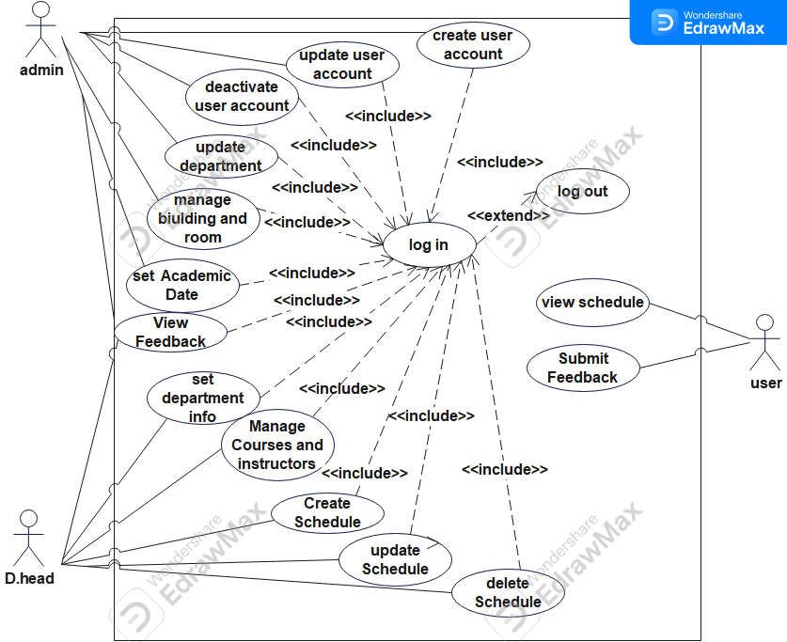
2.3.1.1. Use case Diagram

Slide 25
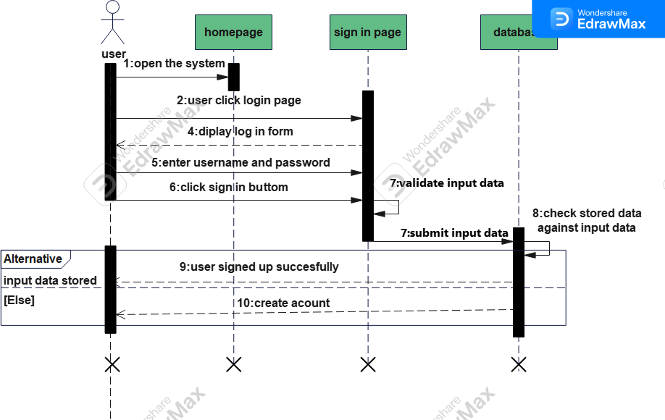
2.3.1.2. Sequence Diagram
Login sequence diagram

Slide 26
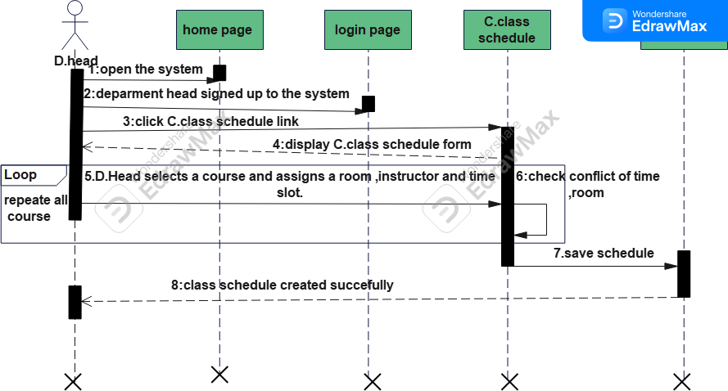
Create class schedule sequence diagram

Slide 27
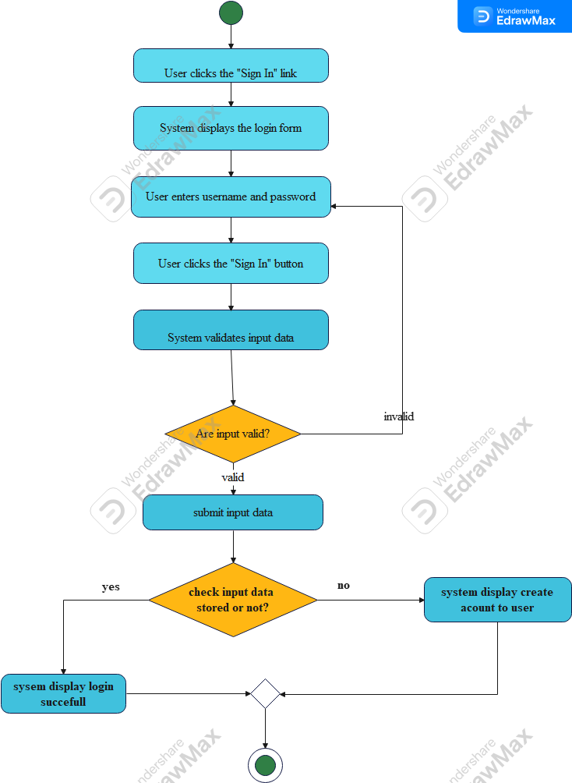
2.3.1.3.Activity Diagram
Activity Diagram for Login

Slide 28
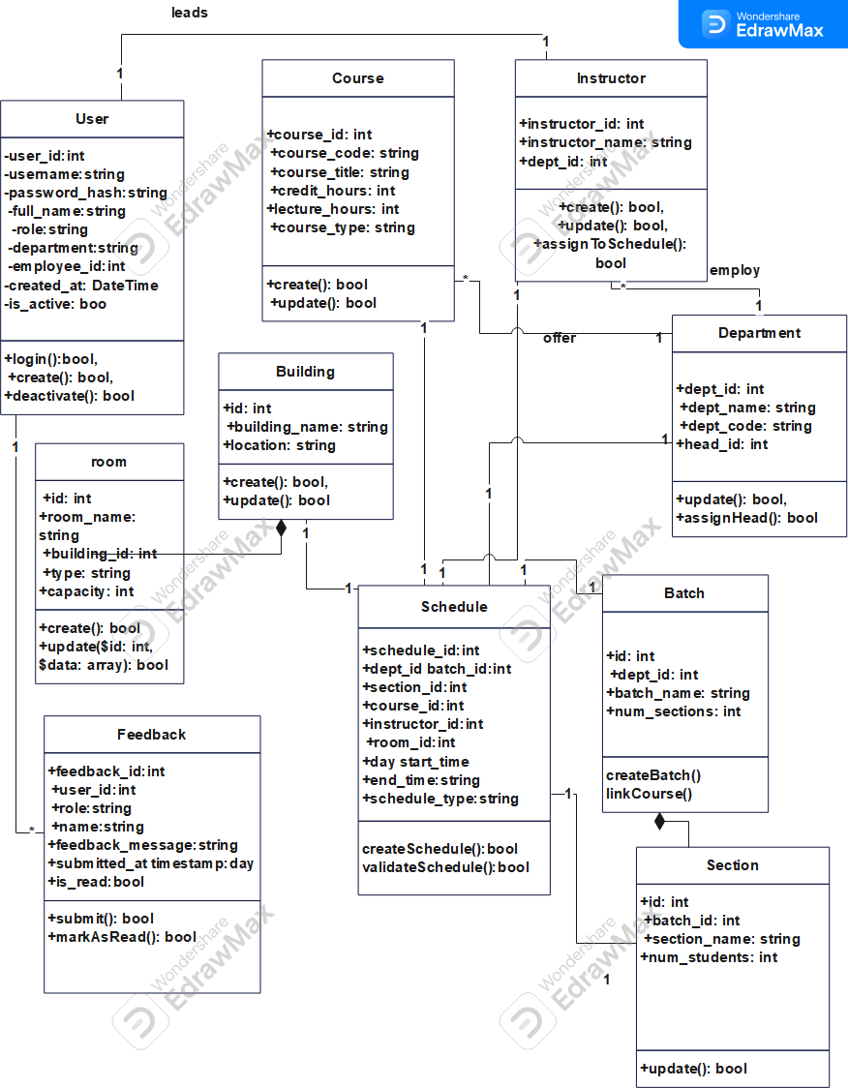
Chapter three: System Design
Design Class Diagram

Slide 29
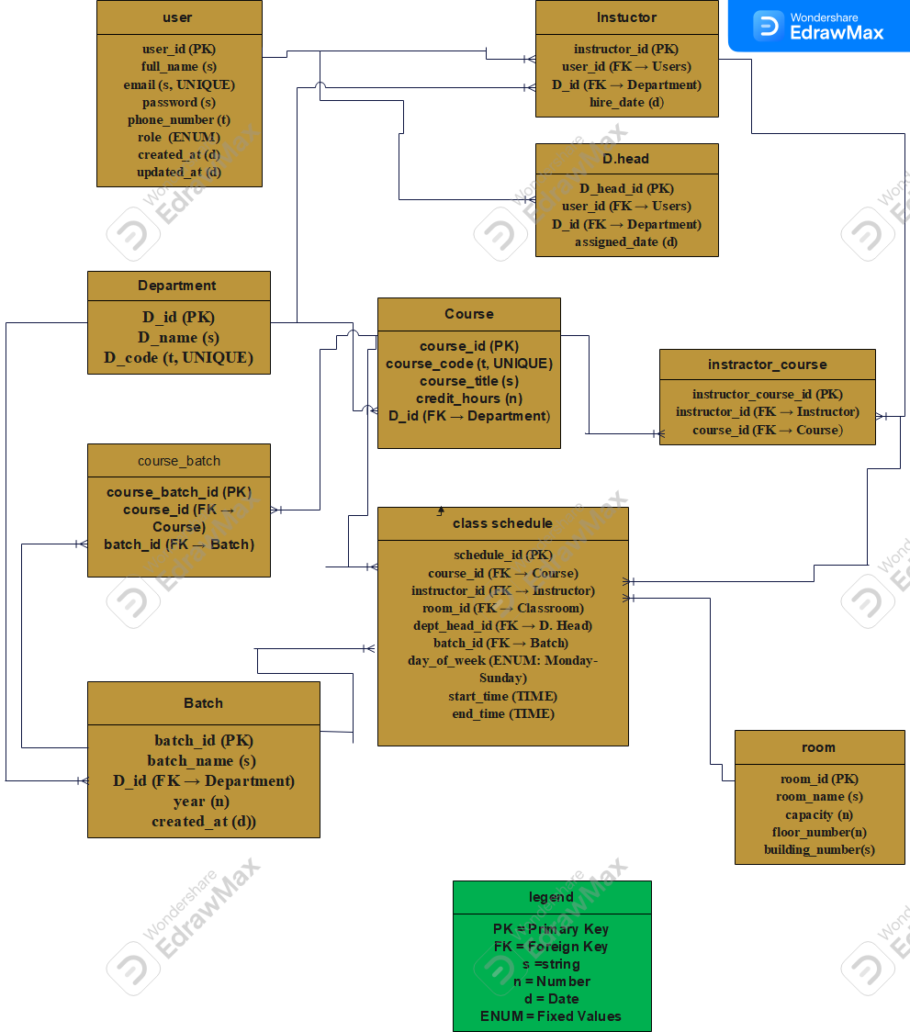
Databasedesign/Physicaldatamodel

Slide 30
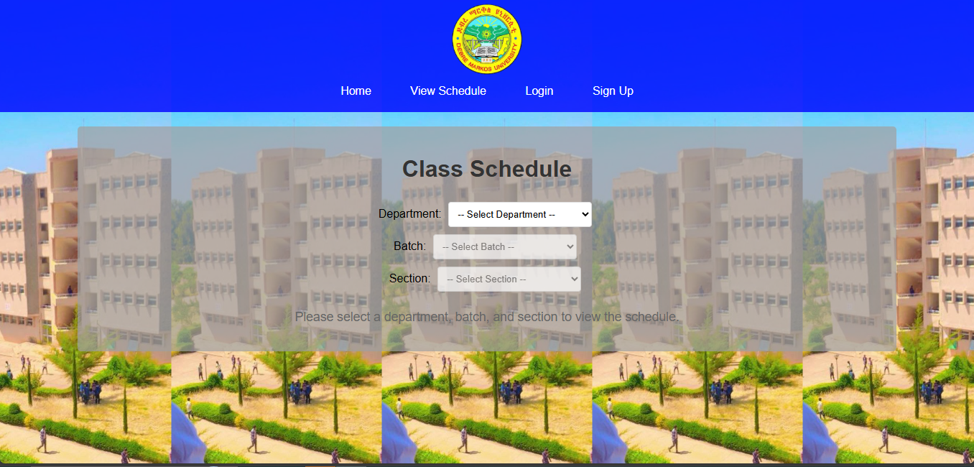
View schedule Interface

Slide 31
CHAPTER 4 :IMPLEMENTATION
Overview of the programming language used
Tools Used to Build the System:
Front-End (What users see and interact with):
HTML –
CSS –
JavaScript –
Back-End (The brain behind the scenes):
PHP –
MySQL –
db_connection.php –

Slide 32
4.2 Algorithms
1. .
Bcrypt for Password Security
We use bcrypt to protect user passwords so no one can see or steal them — not even if the database is hacked
How It Works:
PHP’s password_hash() turns the password into a secure code.
password_verify() checks the code during login.
The real password is never saved or sent anywhere.
2. Schedule Conflict Detection
The system avoids double-booking rooms or teachers at the same time.
How It Works:
When a new schedule is created, the system checks the database to see:
Is this room already taken?
Is this instructor already busy?
If yes, it shows an error and stops the conflict.

Slide 33
cont..
3. Dynamic Filtering (Using JavaScript + AJAX)
Students and instructors can quickly filter schedules by department, batch, or section.
How It Works:
When users choose a department or section:
JavaScript and AJAX send a quick request in the background.
The system updates the visible schedule without reloading the page.

Slide 34
CHAPTER 5: TESTING
In our case, we tested the Class Scheduling System to make sure it:
Works as expected,
Doesn’t crash,
Gives correct results,
Is safe and easy to use.
1. Login Test (User Authentication)
What We Tested:
Can an admin log in with correct username/password?
What happens with the wrong password?
2. Schedule Creation Test
What We Tested:
Can the system create a new class schedule?
Does it prevent double-booking?

Slide 35
cont..
3. Public Schedule Viewing Test
What We Tested:
Can users filter and view schedules by department, batch, and section?
4. Feedback Submission Test
What We Tested:
Can a student send feedback?

